Slide 1
Object Oriented Programming(Java) Lecture 13

Slide 2
Content
Java Exception.
Types of Exception.
Exception Handling.
Example: Java Exception Handling.

Slide 3
Java Exceptions
An exception is an unexpected event that occurs during program execution. It affects the flow of the program instructions which can cause the program to terminate abnormally.
An exception can occur for many reasons. Some of them are:
Invalid user input
Device failure
Loss of network connection
Physical limitations (out of disk memory)
Code errors
Opening a file that is unavailable

Slide 4
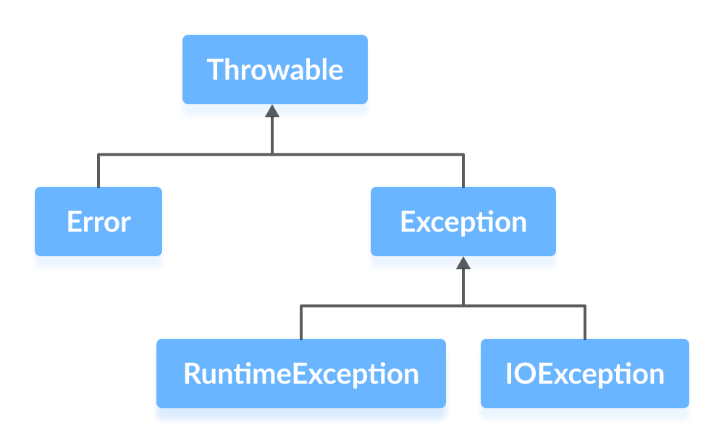
Java Exceptions
Errors represent irrecoverable conditions such as Java virtual machine (JVM) running out of memory, memory leaks, stack overflow errors, library incompatibility, infinite recursion, etc.
Errors are usually beyond the control of the programmer and we should not try to handle errors.
Exceptions can be caught and handled by the program.
When an exception occurs within a method, it creates an object. This object is called the exception object.
It contains information about the exception such as the name and description of the exception and state of the program when the exception occurred.

Slide 5
Runtime Exception
A runtime exception happens due to a programming error. They are also known as unchecked exceptions.
These exceptions are not checked at compile-time but at run-time. Some of the common runtime exceptions are:
Improper use of an API - IllegalArgumentException
Null pointer access (missing the initialization of a variable) - NullPointerException
Out-of-bounds array access - ArrayIndexOutOfBoundsException
Dividing a number by 0 - ArithmeticException

Slide 6
IO Exception
An IOException is also known as a checked exception. They are checked by the compiler at the compile-time and the programmer is prompted to handle these exceptions.
Some of the examples of checked exceptions are:
Trying to open a file that doesn’t exist results in FileNotFoundException
Trying to read past the end of a file

Slide 7
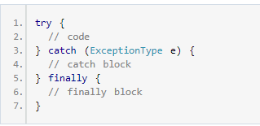
Java Exceptions Handling :

Slide 8
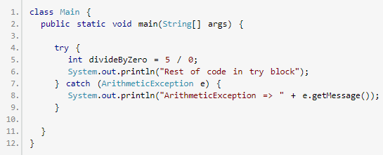
Java Exceptions Handling :

Slide 9
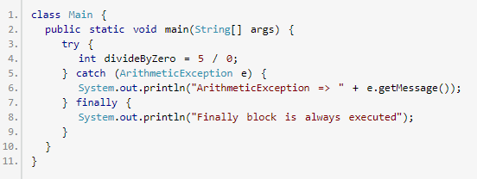
Java Exceptions Handling :

Slide 10
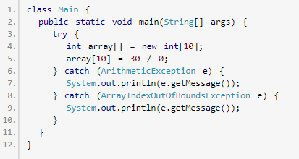
Java Exceptions Handling (Multiple Catch):

Slide 11
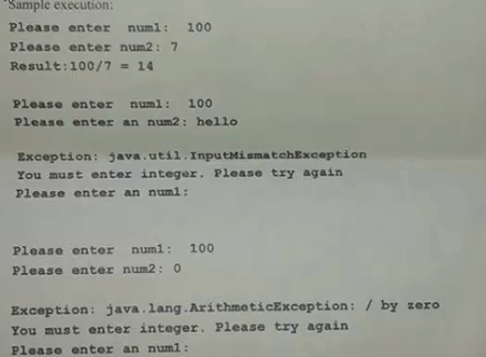
Java Exception Task :

Slide 12
References :
https://www.programiz.com/java-programming/exceptions.

Slide 13
Thanks

